Slide 1
BITS Pilani
Dr. Lavika Goel
Assistant Professor
Department of CSIS
Pilani Campus

Slide 2
Pilani Campus
Implementing subprograms

Slide 3
Agenda
Run time environment
The General Semantics of Calls and Returns
Implementing “Simple” Subprograms
Implementing Subprograms with Stack-Dynamic Local Variables
Nested Subprograms
Implementing Static Scoping
Implementing Dynamic Scoping
Pilani Campus

Slide 4
Run Time Environments
Deals with the layout and allocation of storage locations for the variables.
Pilani Campus

Slide 5
Run time memory
Code
Fixed size code
Global constants and some other statically generated information
Static
Heap
Dynamic memory to be used by the Programmer
Free Memory
Dynamic memory to be allocated during function calls (activation records)
Stack
Pilani Campus

Slide 6
Flow of Execution control
p()
{
statements of p;
q( );
r( );
remaining statements of p
}
Procedure calls are nested in time
If procedure p calls procedure q and procedure r (refer example)
The execution of q starts, the execution of p suspends
The execution of r starts only after execution of q is over
The execution of p resumes when execution of r is over
Pilani Campus

Slide 7
Activation tree
p()
{
statements of p;
q( );
r( );
remaining statements of p
}
q()
{
…
u( );
v( );
…
}
The activations of procedures
during execution of the entire
program is represented by a tree,
called an activation tree.
p()
q()
r()
u()
v()
Sequence of procedure calls corresponds to the preorder traversal of the activation tree
Procedure execution is in LIFO order
Pilani Campus

Slide 8
Activation Tree
Activation Tree - cannot be computed statically
Dynamic – may be different every time the program is run
main
r()
q (1,9)
p (1,9) q(1,3) q (5,9)
p (1,3) q(1,0) q (2,3)
p (5,9) q(5,5) q (7,9)
p (2,3) q(2,1) q (3,3)
p (7,9) q(7,7) q (9,9)
CS C362 Second Semester 2010-2011
Pilani Campus

Slide 9
Run-time Control Flow
Paths in the activation tree from root to some node represent a sequence of active calls at runtime
main
r()
q (1,9)
p (1,9) q(1,3) q (5,9)
p (1,3) q(1,0) q (2,3)
p (5,9) q(5,5) q (7,9)
p (2,3) q(2,1) q (3,3)
p (7,9) q(7,7) q (9,9)
Pilani Campus

Slide 10
The General Semantics of Calls and Returns
The subprogram call and return operations of a language are together called its subprogram linkage
General semantics of calls to a subprogram
Parameter passing methods
Stack-dynamic allocation of local variables
Save the execution status of calling program
Transfer of control and arrange for the return
If subprogram nesting is supported, access to nonlocal variables must be arranged
Pilani Campus

Slide 11
The General Semantics of Calls and Returns
General semantics of subprogram returns:
Out mode and inout mode parameters must have their values returned
Deallocation of stack-dynamic locals
Restore the execution status
Return control to the caller
Pilani Campus

Slide 12
Implementing “Simple” Subprograms
Simple subprograms are those which cannot be nested and all local variables are static.
Call Semantics:
- Save the execution status of the caller - Pass the parameters - Pass the return address to the called - Transfer control to the called
Pilani Campus

Slide 13
Implementing “Simple” Subprograms (continued)
Return Semantics:
If pass-by-value-result or out mode parameters are used, move the current values of those parameters to their corresponding actual parameters
If it is a function, move the functional value to a place the caller can get it
Restore the execution status of the caller
Transfer control back to the caller
Required storage:
Status information, parameters, return address, return value for functions, temporaries
Pilani Campus

Slide 14
Implementing Subprograms
Two separate parts: the actual code and the non-code part (data that can change)
The format, or layout, of the non-code part of an executing subprogram is called an activation record
An activation record instance is a concrete example of an activation record (the collection of data for a particular subprogram activation)
Pilani Campus

Slide 15
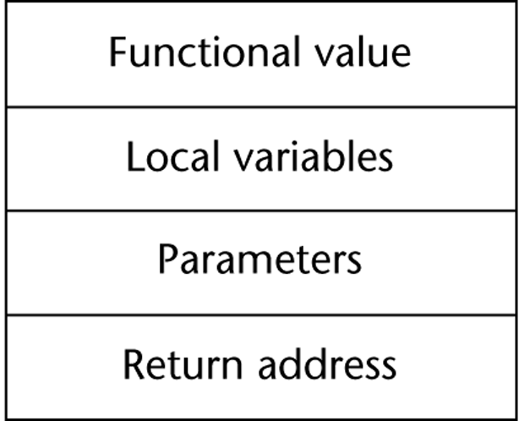
An Activation Record for “Simple” Subprograms
In a simple subprogram, the local variables are static and no nesting is allowed.
Activation record for simple subprograms have fixed size and can be statically allocated.
Recursion is not supported in simple subprograms. Hence only one version of a given subprogram is active at a time.
Pilani Campus

Slide 16
Implementing Subprograms with Stack-Dynamic Local Variables
More complex activation record
The compiler must generate code to cause implicit allocation and deallocation of local variables
Recursion must be supported (adds the possibility of multiple simultaneous activations of a subprogram)
Pilani Campus

Slide 17
(Contd..)
Note:
Every subprogram activation, whether recursive or non-recursive, creates a new instance of the activation record on the run-time stack.
Format of an activation record is fixed at compile time but the size depends upon the function calls.
Pilani Campus

Slide 18
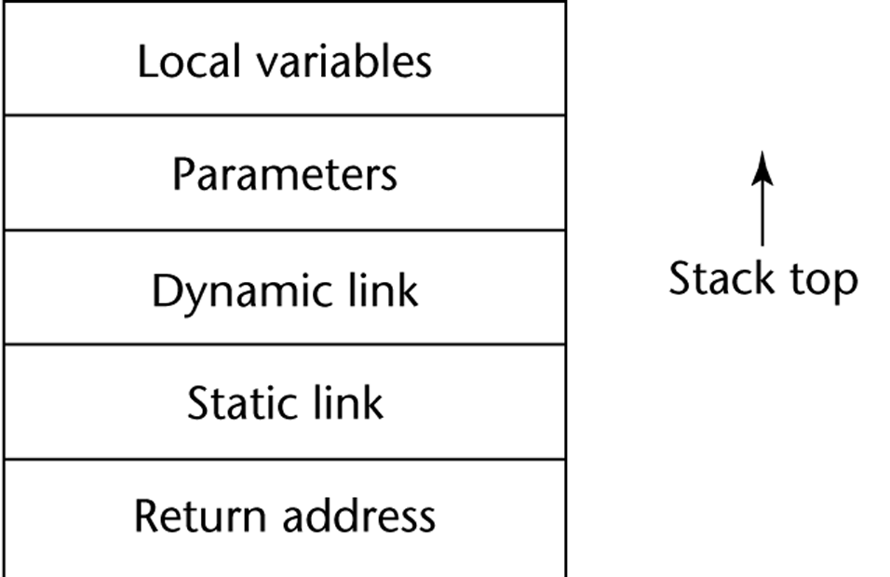
Typical Activation Record for a Subprogram with Stack-Dynamic Local Variables
Return address is the pointer to the instruction following the call in the code segment of the calling program.
Dynamic link (control link) is the pointer to the base of the activation record instance of the caller. (used in both static scoping and dynamic scoping)
Parameters are the values provided by the caller.
Parameters, return address and dynamic link are placed in the activation record instance by the caller, these entries are placed first and local variables are initialized in the called subprogram, so they are placed last.
Pilani Campus

Slide 19
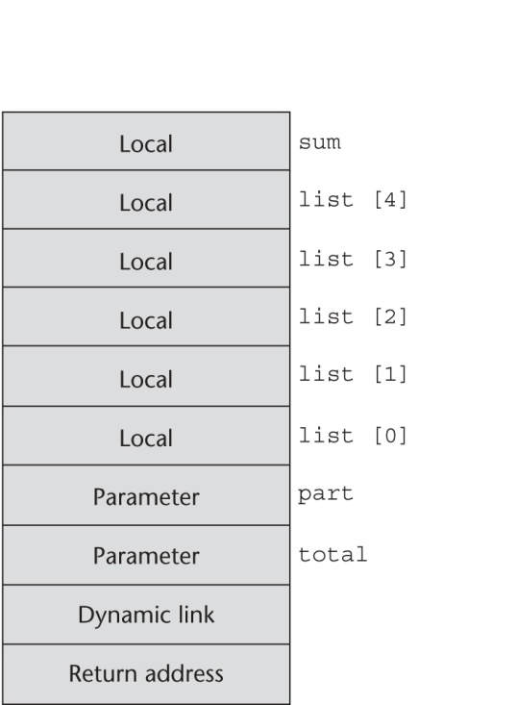
An Example: C Function
void sub(float total, int part)
{
int list[5];
float sum;
…
}
Pilani Campus

Slide 20
Executing a subprogram: Call and return
Initially, the environment pointer (EP) points to the base address of the ARI of the calling program.
When a subprogram is called, the current EP is saved in the new ARI as the dynamic link.
EP is then set to point to the base of the new ARI.
Upon return from the subprogram, the stack top is set to the value of the current EP – 1. This step removes the top ARI corresponding to that of the called subprogram.
EP is set to the dynamic link from the ARI of the called subprogram (that has completed its execution).
EP is used as the base address for accessing the contents of the ARI i.e. local variables and parameters.
Pilani Campus

Slide 21
Revised Semantic Call/Return Actions
Caller Actions:
Create an activation record instance
Save the execution status of the current program unit
Compute and pass the parameters
Pass the return address to the called
Transfer control to the called
Callee actions at the beginning of execution:
Save the old EP in the stack as the dynamic link and create the new value
Allocate local variables
Pilani Campus

Slide 22
Revised Semantic Call/Return Actions (continued)
Callee actions at the end of execution :
If there are pass-by-value-result or out-mode parameters, the current values of those parameters are moved to the corresponding actual parameters
If the subprogram is a function, its value is moved to a place accessible to the caller
Restore the stack pointer by using the value of the current EP-1 and set the EP to the old address using the dynamic link
Restore the execution status of the caller
Transfer control back to the caller
A subprogram is active from the time it is called till the time it completes execution. After the subprogram is inactive, its local scope ceases to exist so its ARI can be destroyed.
Pilani Campus

Slide 23
An example without recursion
Pilani Campus

Slide 24
Stack contents for 3 points in the program
Sequence of function calls:
main calls fun1, fun1 calls fun2 and fun2 calls fun3.
Pilani Campus

Slide 25
(Contd..)
Initially, only ARI of function main and fun1 are on the stack.
When fun1 calls fun2, fun2’s ARI is created on the stack.
When fun2 calls fun3, fun3’s ARI is created on the stack.
When fun3’s execution ends, its ARI is removed from the stack and EP is used to reset the stack top pointer.
Similarly, other ARIs are destroyed as the function call returns to the main function. At the end, the stack has only the ARI of the main function.
Pilani Campus

Slide 26
Dynamic Chain and Local Offset
The collection of dynamic links in the stack at a given time is called the dynamic chain, or call chain
Local variables can be accessed by their offset from the beginning of the activation record, whose address is in the EP. This offset is called the local_offset.
The local_offset of a local variable can be determined by the compiler at compile time.
We assume that each variable takes one position in the activation record. Example, the first local variable declared in a subprogram would be allocated in the activation record two positions + the no. of parameters from the bottom (the first 2 positions are for return address and dynamic link).
Pilani Campus

Slide 27
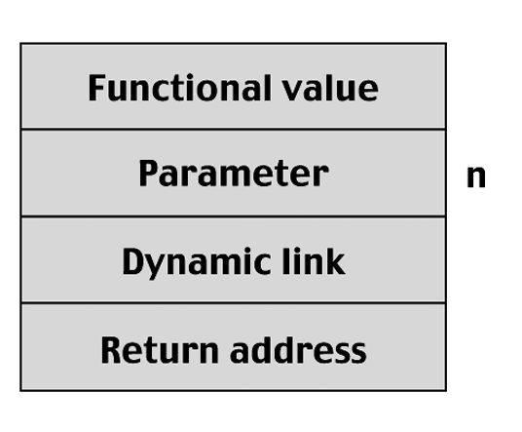
Example with recursion
Pilani Campus

Slide 28
Stack contents at position 1 in 3 executions
Pilani Campus

Slide 29
Stack contents during execution of main and factorial
Pilani Campus

Slide 30
(Contd..)
Pilani Campus

Slide 31
Nested Subprograms
Some non-C-based static-scoped languages (e.g., Fortran, Ada, Python, JavaScript, Ruby) use stack-dynamic local variables and allow subprograms to be nested
All variables that can be non-locally accessed reside in some activation record instance in the stack
The process of locating a non-local reference:
Find the correct activation record instance
Determine the correct offset within that activation record instance
Pilani Campus

Slide 32
Locating a Non-local Reference
Finding the offset is easy
Finding the correct activation record instance
Static semantic rules guarantee that all non-local variables that can be referenced have been allocated in some activation record instance that is on the stack when the reference is made
Pilani Campus

Slide 33
Static Scoping
A static chain is a chain of static links that connects certain activation record instances
The static link (access link) in an activation record instance for subprogram A points to the activation record instance of A's static parent.
The static chain from an activation record instance connects it to all of its static ancestors.
We can find the correct ARI for a non-local variable using static links: When a reference to a non-local variable is made, the ARI containing the variable can be found by searching the static chain until a static ancestor ARI is found that contains the variable.
Also, since the scoping is static, the compiler can identify the non-local variables and the length of the static chain to be followed to reach the ARI of the referenced non-local variable.
Pilani Campus

Slide 34
Static Scoping (continued)
Static_depth is an integer associated with a static scope whose value is the depth of nesting of that scope
The length of the static chain needed to reach the correct ARI of the non-local variable is given by the chain_offset or nesting_depth. It is defined as the difference between the static_depth of the subprogram containing the reference and the static depth of the subprogram containing the declaration of that non-local variable.
A reference to a variable can be represented by the pair: (chain_offset, local_offset),
where local_offset is the offset in the activation record of the variable being referenced and chain_offset is the no. of links to the correct ARI.
Pilani Campus

Slide 35
Example Ada Program
Pilani Campus

Slide 36
Example Ada Program (continued)
Call sequence for Main_2
Main_2 calls Bigsub
Bigsub calls Sub2
Sub2 calls Sub3
Sub3 calls Sub1
Pilani Campus

Slide 37
Stack Contents
Pilani Campus

Slide 38
(Contd..)
Position 1 in sub1:
A: (0,3) [A is local variable]
B: (1,4)
C: (1,5)
Position 2 in sub3:
E: (0,4)
B: (1,4)
A: (2,3)
Position 3 in sub2:
A: (1,3)
D: Static semantic error
E: (0, 5)
Pilani Campus

Slide 39
Example: Static & Dynamic Scoping
main()
{
P()
{
int x;
x=1;
Q()
{
x=x+5;
printf(“%d”, x);
}
R()
{
int x;
x=2;
x=x+10;
Q();
x=x+5;
printf(“%d”, x);
}
Q();
R();
}
P();
}
Output:
Static scoping: 6 11 17
Dynamic scoping: 6 17 22
Pilani Campus

Slide 40
Implementing Dynamic Scoping
non-local references are found by searching the activation record instances on the dynamic chain - Length of the chain cannot be statically determined
Pilani Campus

Slide 41
Summary
Subprograms with stack-dynamic local variables and nested subprograms have two components
actual code
activation record
Activation record instances contain formal parameters and local variables among other things
Static chains are the primary method of implementing accesses to non-local variables in static-scoped languages with nested subprograms
Access to non-local variables in dynamic-scoped languages can be implemented by use of the dynamic chain.
Pilani Campus

